Slide 1
AAP Infection Prevention and Control ECHO
Insert Date

Slide 2
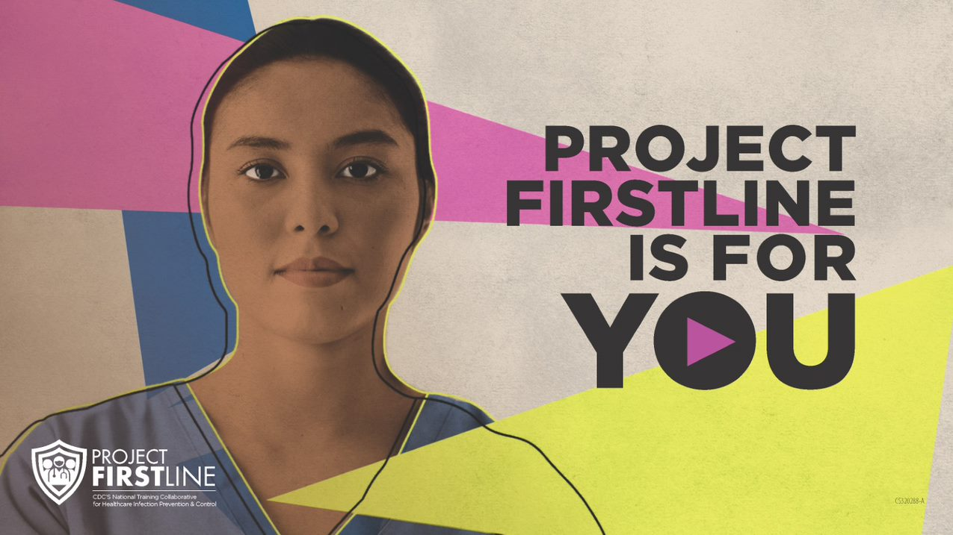
Acknowledgements
Project Firstline is a national collaborative led by the US Centers for Disease Control and Prevention (CDC) to provide infection control training and education to frontline healthcare workers and public health personnel. AAP is proud to partner with Project Firstline, as supported through Cooperative Agreement CDC-RFA-OT18-1802. CDC is an agency within the Department of Health and Human Services (HHS). The contents of this program do not necessarily represent the policies of AAP, CDC or HHS and should not be considered an endorsement by the Federal Government.

Slide 3
Faculty Team
Name
Role

Slide 4
Infection Control Practices Before, During, and After Administering Vaccines
(Insert Speaker Photo Here)
Speaker Name/Credentials
Date Presented

Slide 5
Disclosures
I have no relevant financial relationships with the manufacturer(s) of any commercial product(s) and/or provider of commercial services discussed in this CME activity.
I do not intend to discuss an unapproved/investigative use of a commercial product/device in our presentation.

Slide 6
Objectives
Describe why having safe vaccine administration practices is important in health care settings
Share strategies and best practices for safe administration of vaccines

Slide 7
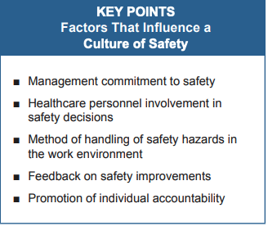
Culture of Safety
Shared commitment of management and employees to ensure the safety of the work environment.
Permeates all aspects of the work environment.
It encourages every individual in an organization to project a level of awareness and accountability for safety.
https://www.cdc.gov/sharpssafety/pdf/sharpsworkbook_2008.pdf

Slide 8
Injection Safety
Measures taken to perform injections in a safe manner for patients and providers
Prevent harms such as needlestick injuries
Prevent transmission of infectious diseases from:
- Patient to patient
- Provider to patient
- Patient to Provider

Slide 9
Definitions
Single-dose vials Multi-dose vials | A single-dose or single-use vial is a vial of liquid medication intended for injection or infusion that is meant for use in a single patient for a single case, procedure, injection. A multi-dose vial is a vial of liquid medication intended for injection or infusion that contains more than one dose of medication. Multi-dose and single-dose vials are labeled as such by the manufacturer.

Slide 10
Multi-Dose Vials are Different
Why?
Multi-dose vaccine vials are accessed by a new needle and syringe more than once, to pull out individual doses for separate patients.
Accessing the vial more than once can be an infection control issue.
Multi-dose vials are different from single-dose vials in several ways and require important injection safety actions.

Slide 11
How to Safely Use a Multi-Dose Vial
1
Always prepare multi-dose vial injections in a clean, designated area away from patient care spaces
2
Clean your hands before touching the vial
3
Check the label to make sure it is a multi-dose vial

Slide 12
How to Safely Use a Multi-Dose Vial
4
Check to make sure the vaccine is not expired or “beyond use”
5
Look and see if the vaccine appears the way the vaccine manufacture tells you it should
6
Use brand-new, sterile needles and syringes for every vaccine dose

Slide 13
How to Safely Use a Multi-Dose Vial
7
Disinfect the top part of the vial (the vial stopper) with an alcohol prep pad – every time
8
Make sure the top is dry before sticking the needle in it
9
When you first put a needle in, write the date and time it was opened on the label

Slide 14
How to Safely Use a Multi-Dose Vial
10
Follow the vaccine manufacture's instructions for storage and disposal
11
Never “pool” doses (combine partial doses from multiple vials to make one dose for a patient)

Slide 15
Contaminated Vaccines CANNOT Be Used
If a needle or syringe gets contaminated and goes into the vial, it will contaminate the rest of the doses of vaccine inside the vial.
If the vaccine is contaminated, it cannot be used anymore and must be thrown away.

Slide 16
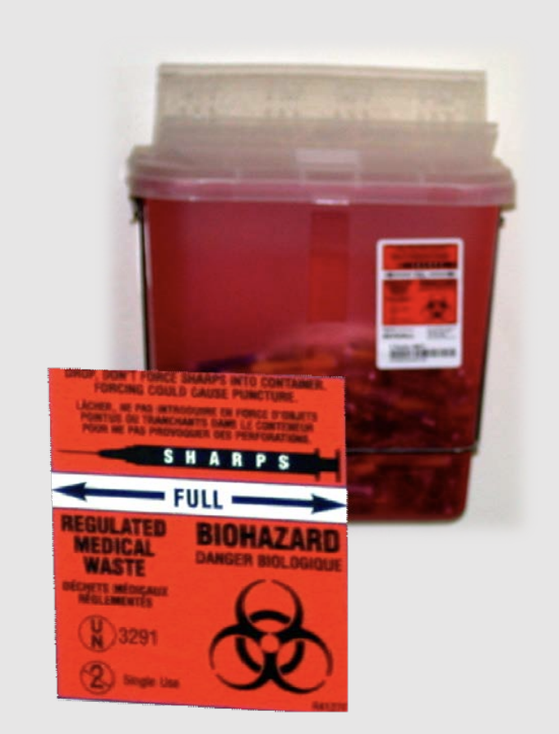
Dispose of Used sharps safely
Dispose of used sharps at their point of use in a sharps container that is closable, puncture-resistant, and leakproof.
Do not remove used needles from disposable syringes.
Do not bend, break, or otherwise manipulate used needles by hand.
Ensure that sharps containers are placed in an area that is not easily accessible by visitors, particularly children
Securely seal and replace sharps containers when they become 75% full.

Slide 17
Needlestick injuries
Have a bloodborne pathogen exposure plan in place
Implement Procedures for Reporting and Examining Sharps Injuries and Injury Hazards
Information is important for prevention planning
Healthcare personnel must understand reporting procedures and be motivated to report exposures
Workbook for Designing, Implementing and Evaluating a Sharps Injury Prevention Program

Slide 18
One Needle, One Syringe, Only One Time
The CDC has developed resources to support the understanding of the basics of injection safety.
Resources include:
FAQs
Checklists
Patient handouts
Videos on clinical practices
Posters
https://www.cdc.gov/injectionsafety/one-and-only.html

Slide 19
Closing
A culture of safety, including injection safety, requires a commitment from everyone.
Multi-dose vials require a specific set of safety procedures that are different from those for single-dose vials or multi-dose vials used with only one patient.
Have a plan in place for reporting and examining sharps injuries.

Slide 20
Resources
American Academy of Pediatrics COVID-19 Guidance and Resources
COVID Town Halls
Practice Management Tips
Preparing for Flu Season
Discounts on PPE and COVID-19 Supplies
Centers for Disease Control and Prevention
Standard Precautions
Transmission-Based Precautions
Clinical Questions about COVID-19: Questions and Answers
Workbook for Designing, Implementing and Evaluating a Sharps Injury Prevention Program
Project Firstline
Notes:
STOP RECORDING

Slide 21
Prepare the Vial
Q: Where should multi-dose vials be prepared?
A: Prepare the vial in a quiet, private space. Never bring multi- dose vials into patient care spaces.

Slide 22
Check the Vial
Q: What do you want to check before using the vial?
A: Check the label to make sure it is a multi-dose vial, and it is not expired. Also check to make sure the vaccine looks the way it is supposed to.

Slide 23
Disinfect the top of the vial
Q: What do you want to check before using the vial?
A: Disinfect the top of the vial with an alcohol prep pad to kill any germs on the top, so you don’t push germs into the vial when you insert the needle. Let the top dry before you insert the needle.

Slide 24
Access the Vial
Q: What do you need to do the first time you open a multi-dose vaccine vial?
A: How long you can use the vaccine after you first access the vial varies by product. Writing the date and time the vial was opened on the label helps prevent vaccine from being given to a patient beyond its use date.

Slide 25
Vaccine in the vial
Q: What do you do if there is a little bit of vaccine left in the vial, but it’s not enough for a full dose?
A: Throw the remaining vaccine away. Never combine doses from different vials or give someone less than a full dose.

